Slide 1
Reinvent business productivity with Microsoft Dynamics 365 and Microsoft Office 365

Slide 2
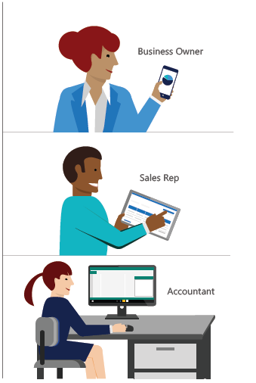
To stand out from the competition, businesses need to make every minute count and every customer engagement shine.
Microsoft Dynamics 365 Business Central is an all-in-one business management solution that helps businesses manage financials, sales, service and operations easier and faster from day one.
This e-book explores how the solution integrates with Office 365 to connect business processes and personal productivity like never before, bringing insight and efficiency to your daily tasks.
We will cover three day-in-the-life scenarios that illustrate how Microsoft’s unique capabilities make business owners, sales representatives, and accountants more productive – ultimately improving customer experiences and company performance.

Slide 3
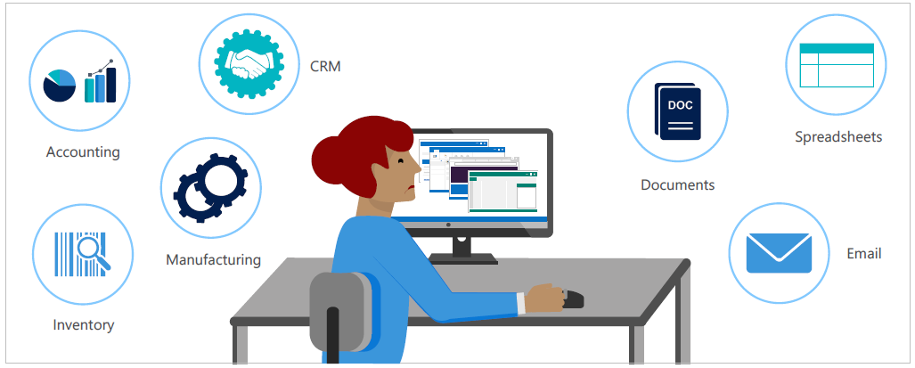
Disconnected systems hold businesses back
If you’re a business owner, your work day often begins at home, triaging emails early in the morning. Having grown the business from the ground up, you know your customers and vendors, and you’re still involved in day-to-day operations. But the bigger the company gets, the more complex your business processes become.
Each email adds something to your to-do list, which typically requires transitioning to a different application. You use accounting software to prepare an invoice, a CRM system to mange your contacts and sales pipeline, and perhaps yet another manufacturing solution to track production or inventory.
Switching back and forth between fragmented, stand-alone solutions takes time and often requires duplicate data entry. This diminished productivity stifles your ability to scale and cuts into time you could spend developing new business.
To keep up the pace of your growth, you’re likely considering the move to a more comprehensive business management solution. Microsoft Dynamics 365 Business Central, helps you get through administrative tasks quickly and easily so you focus on the big picture, and your team can spend more time taking care of customers. Let’s dive into how Microsoft can help.

Slide 4
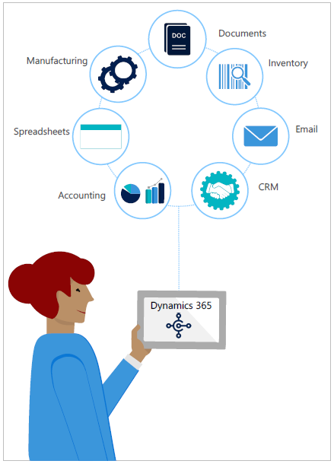
Connect people, processes, and systems
Reimagine productivity with Dynamics 365 and Office 365
Microsoft brings the worlds of business processes and personal productivity together, connecting your people, processes, and systems like never before.
Right now, your employees might be the only common link between your business systems and the email, spreadsheet, and word processing tools you use every day. This means they waste a lot of time flipping between apps or cutting and pasting, which can lead to data entry errors. Connected business solutions from Microsoft help pull everything together so your people don’t
have to.
Together, Microsoft Dynamics 365 Business Central and Office 365 help you:
Drive productivity by reducing time spent switching between stand-alone apps
Foster collaboration and communication by breaking down internal silos and broadening visibility across the organization
Accelerate user adoption and lower training time with a seamless user experience
Let’s take a look at some scenarios where Dynamics 365 and Office 365 work together to make your people more productive and your business more efficient.

Slide 5
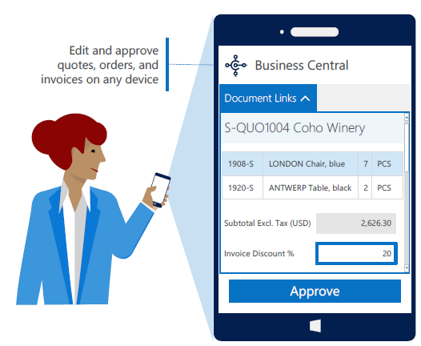
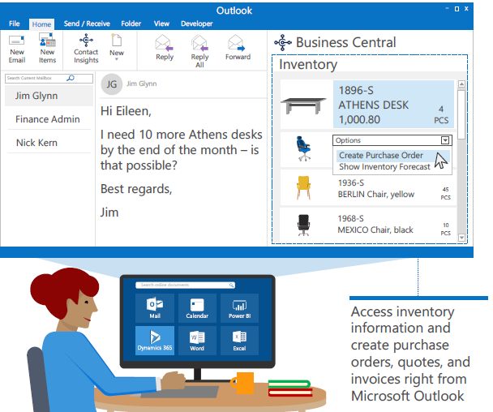
As a business owner, imagine you receive an email from a
high-priority customer who urgently needs an order delivered in a short timeframe. With Dynamics 365 Business Central, you can find the information you need and act on it without searching disparate systems or coordinating with other departments. Without leaving your inbox, you check inventory and discover that you don’t have enough stock on hand to fulfill the order. In the same interface, you create and send both a purchase order to the vendor and a quote to your customer, moving on to your next task within minutes.
Dynamics 365 workflows also help you secure processes and work on the go. Suppose you are out of the office and an email alerts you that a sales quote has exceeded your established 10% maximum discount. Right from your mobile inbox, you quickly review the quote and check the customer’s order history, account status, and credit limit. You make an informed decision to approve the discount, which automatically updates the quote and notifies the sales rep that it’s ready to be sent to the customer.
Edit and approve quotes, orders and invoices on any device
Access inventory information and create purchase orders, quotes and invoices right from Microsoft Outlook
With Dynamics 365 and Office 365 working together, you can take quick action right from your email – allowing you to spend more time managing your business and connecting with customers.

Slide 6
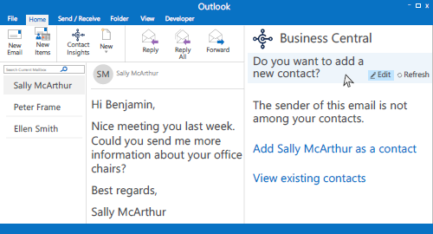
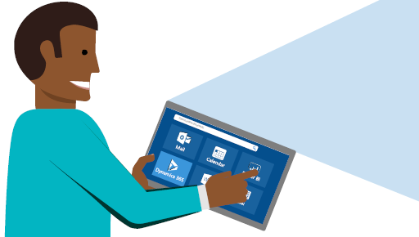
You know how critical it is to keep your sales team connected in the office and on the go. Dynamics 365 and Office 365 simplifies and automates daily tasks to keep your sales team focused on managing sales.
Your sales rep receives an email from a customer requesting a quote on some items. The system recognizes the sender, enabling him to easily pull up customer card within Outlook. From this dashboard, he reviews the account – including the customer’s existing quotes, ongoing orders, and sales history. As he’s creating the quote, customer and product information auto-populate, helping him get it done faster.
While he was sending the sales quote, a note hit his inbox from a potential customer he met at a recent event. The system recognizes that their email address is not in the customer database, and prompts him to add them. Without leaving Outlook, he creates their profile in the Dynamics 365 app.
This kind of automation reduces time spent on administrative tasks, allowing your sales team to quickly respond to inquiries and ultimately improve customer interactions.
Use Microsoft Word to modify quote and invoice templates in Dynamics
Set up or update customers and vendors in Dynamics 365 from Outlook

Slide 7
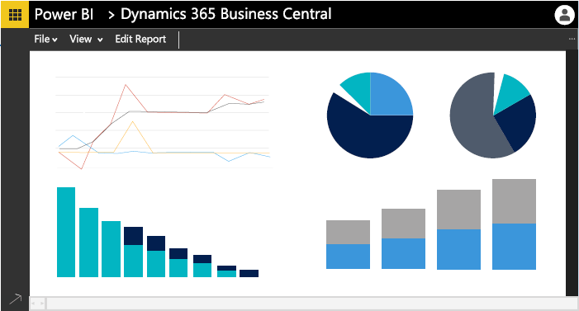
Your accountants run a crucial piece of the business. Dynamics 365 make an accountant's day easier by simplifying reporting, streamlining month-end close, and reducing data entry errors.
Her day starts in the Dynamics 365 app, where she is preparing the monthly P&L statement. She needs to edit multiple invoices at once, so she opens the invoice list in Microsoft Excel. In a matter of minutes, she adds a new batch of invoices and updates the status of several others. With just one click, she publishes the data back to the Dynamics 365 app, where it’s automatically refreshed.
Wanting a deeper analysis of the month’s revenue, she switches to Microsoft Power BI. There she has multiple ways to analyze Dynamics 365 data, including the revenue information she just updated. Through rich visuals and custom dashboards, she gains insights she couldn’t get from standard reports.
With Dynamics 365 Business Central, you get an
end-to-end view of your business and built-in intelligence that helps you make more informed decisions.
Excel
File
Home
Insert Draw
Page Layout
Data Review View Developer
G6
A
fx
B
c
1
Microsoft Dynamics
 | No | Name | Salesperson_Code
2 | 10000 | Coho Winery | MD
3 | 20000 | Trey Research | MD
4 | 30000 | Lifeware, Inc. | PS
5 | 40000 | Alpine Ski | PS
 | Sheet1
Excel Add-In
Projects
Administration
New Refresh Publish Filter Design
4
+ 100%
Refresh data in Excel without
having to return to the financial
system
Search online documents
Connect Dynamics 365 data to Power BI for advanced analytics

Slide 8
Don’t let disconnected systems get in the way of your business success. Take the next steps to bring your people, processes, and systems together in the cloud to help your business thrive.
Contact us today to get started:
Company Name
Email
Phone
Website
© 2018 Microsoft Corporation. All rights reserved.
This document is provided “as-is”. Information and views expressed in this document, including URL and other Internet website references, may change without notice. You bear the risk of using it.
This document does not provide you with any legal rights to any intellectual property in any Microsoft product. You may copy and use this document for your internal reference purposes. Some examples are for illustration only and are fictitious. No real association is intended or inferred.

